Slide 1
Role of Physics Education for Technological Development for Employment and Self Productivity in Namibia
Presenter:
Prof. Onjefu Sylvanus (NUST)
BSc. Physics, MSc. Environmental Physics, PhD. Environmental Radiation Physics

Slide 2

What is Physics?
Physics is the father of Physical Sciences
These Physical Sciences make up 6
department;
Physics
Chemistry
Mathematics
Computer Science
Geology
Statistics

Slide 3

What is Physics Cont.
Physics investigates the physical laws governing
the universe through the study of the interaction of
matter and energy
It also deals with the applications in solving practical
and industrial problems

Slide 4

Why do we study Physics?
Physics is the core of the sciences
It is the bedrock of any nation’s economic
emancipation.
It is the cornerstone for engineering, medicine,
pharmacy, agriculture
With physics a nation becomes a super power

Slide 5
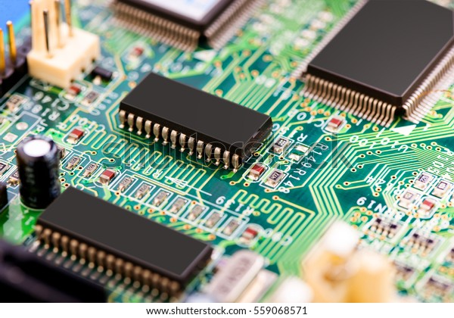
Contribution of Physics to Society
Physics plays a vital role in the development
of any society for example;
In electronics development of
transistors
Diodes
Integrated circuit
All these allows for the development of radio
transmitters, televisions, radio tapes

Slide 6
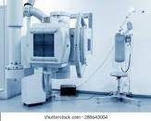
Contribution of Physics to Society Cont.
In Health care
X-rays
Scan machines
Treatment of cancers
(Medical Physicist & Nuclear medicine)

Slide 7

Contribution of Physics to Society Cont.
In Mining
Geophysics
Petro Physics
Radiation safety Officer (RSO)

Slide 8


Contribution of Physics to Society Cont.
In Energy
Renewable energy
Energy storage
Nuclear energy
Green hydrogen

Slide 9

Contribution of Physics to Society Cont.
In Computation, Robotic and Satellite
Computers
Robotic
Satellite (weather prediction)
(Atmospheric physics) (Space physics)

Slide 10

Job Opportunity for Physicists
Secondary School
Academic Research in Universities
Namibia Standard Institute
Mining industries
Power Plants
Hospitals
Quality Assurance officers in companies
Ministry of Mines and Energy
Air port

Slide 11

Job Opportunity for Physicists Cont.
Weather station
Consultancy in Environmental impact
Nam Water
Telecom industry
Military Services (Communication operators)
The list is endless

Slide 12

Problems facing physics education
Poor teacher’s motivation
Lack of teaching aids
Inadequate laboratory facilities
Poor / uncommitted learner/students
Inadequate number of indigenous textbook

Slide 13

Recommendations
Recruitment of more Namibian physics teacher
Recruitment should be based on merit
Modern laboratory equipment be supplied to all school
Curriculum be review to meet the present advancement
Learners/students should be counsel and guided properly
Political deception should be avoided in education sector
Physics teacher and science teachers should be motivated by given incentives (special salary scale)

Slide 14

THANK YOU

